Slide 1
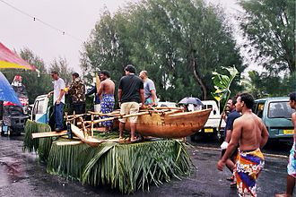
Cook Islands Data Visualization

Slide 2
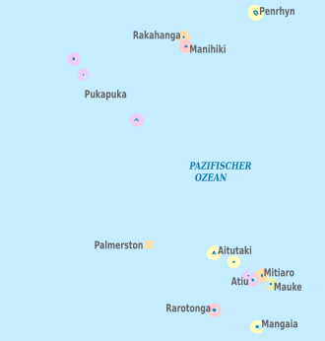
Application Overview
1. Interactive Shiny application showcasing data about the Cook Islands.
2. Features include:
- Maps and geospatial visualizations.
- Statistical insights and dynamic charts.
3. Focus: Highlighting trends in tourism, economics, and demographics.

Slide 3

Key Features
1. Geospatial Visualizations:
- Interactive maps displaying island data.
2. Statistical Analysis:
- Tourism trends.
- Economic indicators and demographic breakdowns.
3. Dynamic Filtering:
- Users can filter and explore data in real-time.

Slide 4

User Experience
1. Intuitive interface with interactive elements.
2. Key use cases:
- Academic research.
- Policy planning for the Cook Islands.
- General audience exploring Cook Islands insights.
3. Real-time data updates enhance engagement.

Slide 5
Conclusion and Next Steps
1. The application provides valuable insights into the Cook Islands.
2. Opportunities for future improvements:
- Expanding datasets (e.g., climate, historical trends).
- Adding predictive analytics.
3. Potential for broader applications in regional planning and tourism.

